Slide 1
Rohit Kumar TUngana
Ke-logger and Security

Slide 2
PROJECT TITLE
KEY-LOGGER AND SECURITY

Slide 3
AGENDA
The main agenda of the keylogger is that are primarily used
by attackers to capture sensitive information without the victims knowledge.
Some of the key points of the agenda for a keylogger
Personal communication: capture text from instant messaging
applications and social media.
Behavior Tracking: monitor application usage and document
interaction.

Slide 4
PROBLEM STATEMENT
Key loggers present a significant security threat by capturing sensitive user information, leading to unauthorized access and data breaches. This problem necessitates the development of sophisticated security measures, user education ,and robust organizational policies to mitigate the risks associated with keyloggers. The problem in the content of keyloggers and security typically revolves around the following key points:
Unauthorized Access and Data Theft.
User Privacy Violation.
Detection and Prevention.
Impact on Organizations.
Legal and Ethic Issues.
Countermeasures and Security Practices.

Slide 5
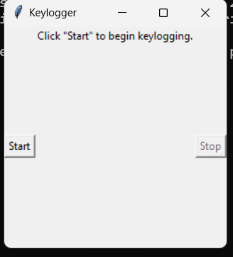
PROJECT OVERVIEW
The Overview of the project is: In this project we had a code to execute and use the keylogger and can know the user information everything what they are typing. So, by executing the code the out put will be:
by clicking start option the process will begin and the information will be start capturing

Slide 6
WHO ARE THE END USERS ?
Individual Users: Interested in personal privacy and protection of their sensitive information. Business and Financial Institutions: Focused on protecting client data, maintaining trust, and ensuring compliance. IT and Security Professionals: Tasked with implementing, managing, and improving security measures to safeguard against keyloggers. Government and regulatory Bodies: Ensure laws and regulations are followed to protect the public and organizational data from cyber threat. Developers and Technology providers: Innovate and provide solutions to detect and mitigate keylogging threats

Slide 7
YOUR SOLUTION AND ITS VALIABLE PROPORTION
For developing and implementing security solutions against key loggers, the value proposition includes:
Enhanced Security: Providing robust protection against keyloggers ensures the sensitive information and maintains user trust.
Compliance: Helping organizations comply with data protection regulations and avoid legal penalties.
Operational Integrity: Preventing data breach's and cyber attacks that could disrupt operations and result in significant financial losses.

Slide 8
THE WOW IN YOUR SOLUTION
In this solution I clearly observed that if we try we can easily get the data of the user without their permission. It has advanced detection algorithms, comprehensive protection measures with centric features.
Some of the elements that contribute to a compiling keylogger solution is: 1. Advanced Detection Algorithms. 2. Comprehensive Protection. 3. User-Friendly Interface. 4. Stealth Mode Operation. 5. Cross-Platform Compatibility. 6. Educational Resources and Support.

Slide 9
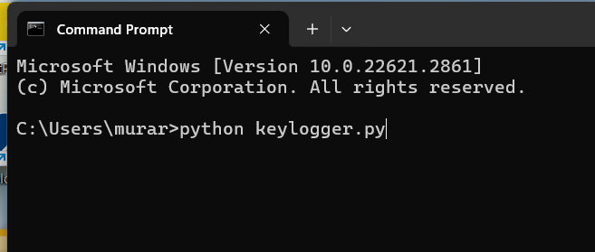

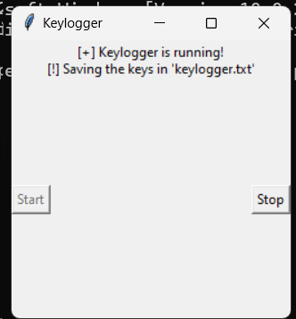
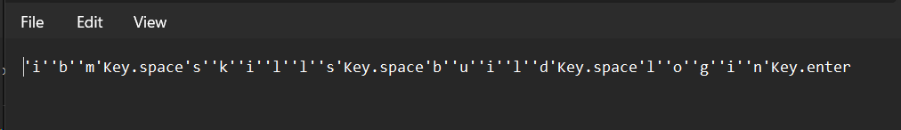
MODELLING

Slide 10
RESULT
The results we get in this keylogger is: we can find the data that user use. Keylogger records keystrokes: Legitimate use: Monitor employee productivity. Illegal uses: Steal passwords, usernames, and other personal /corporate data. There are ways to protect yourself:
1. Be aware of what’s installed on your computer. 2. Use caution when surfing the internet. 3. Keep your computer’s security software updated.
Example of keylogger’s output:

Slide 11
PROJECT LINK
https://github.com/trohit7795/KeyLoggers.git

